Slide 1
FRESHLENS
Sprint 2 - TEAM-4 Sierra

Slide 2
AGENDA
Project Review
MVP
Technologies
Algorithms
Diagrams
Product and Sprint Backlog
Metrics
Retrospective
Sprint 3 Plans
Demo

Slide 3
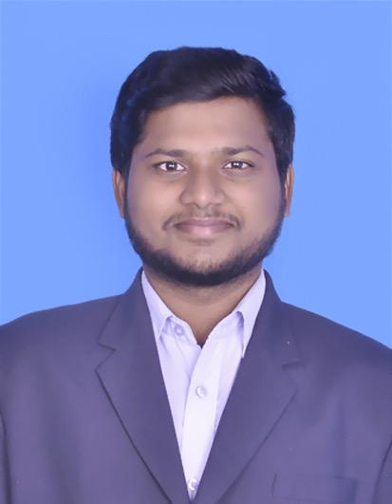
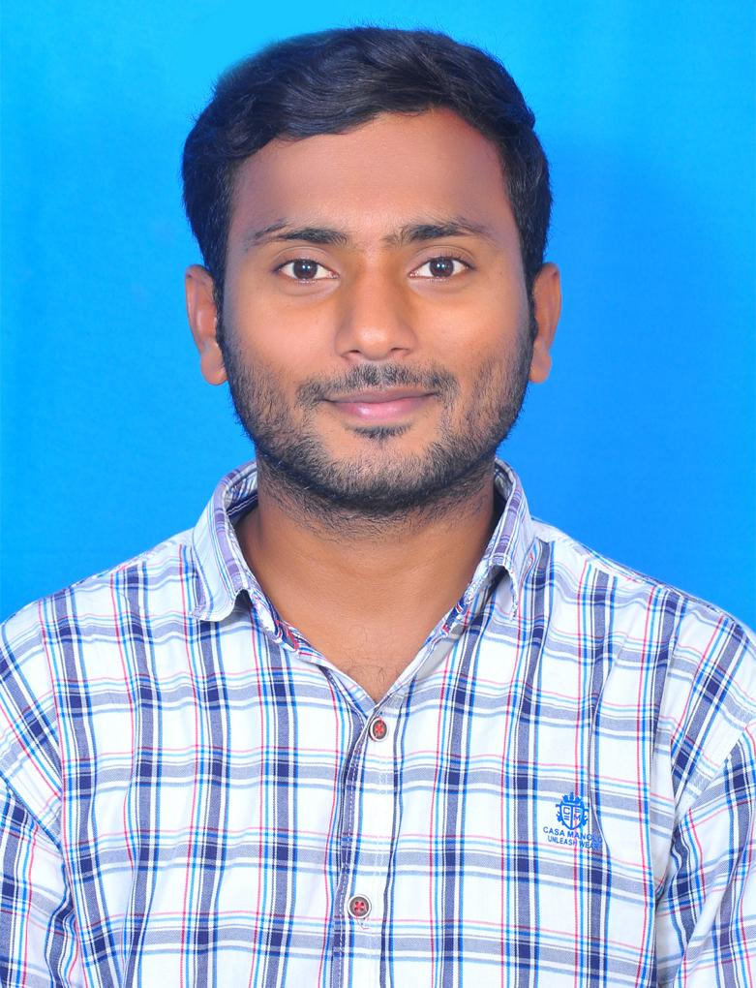
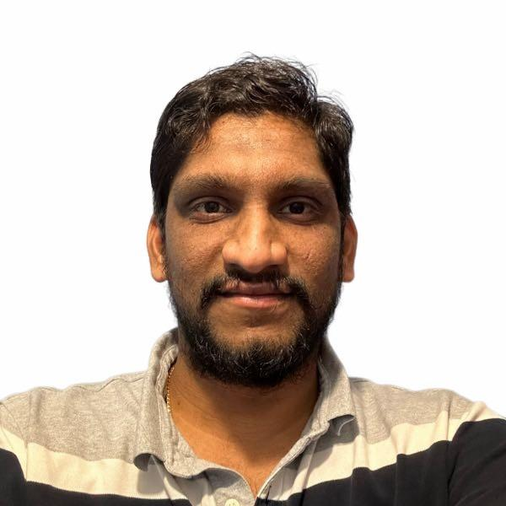
TEAM MEMBERS
Chandu Pentela Project Manager
Jaya Venkata Vara Sai Prakash Perumalla Backend Developer
Banoth Ashok Backend Developer

Slide 4
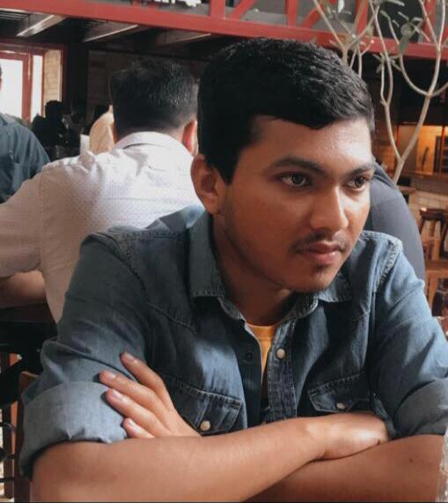
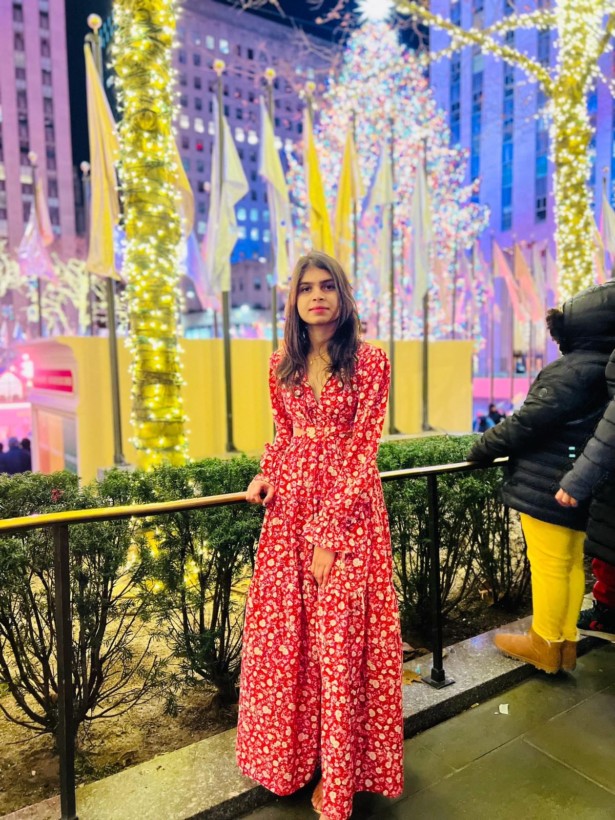
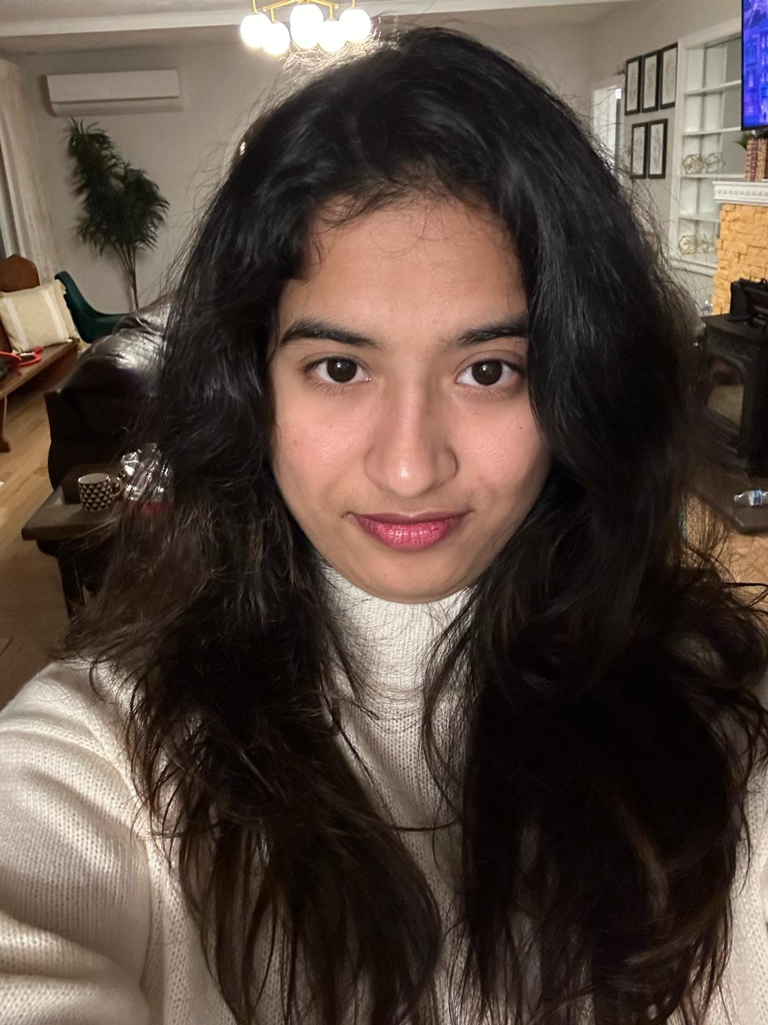
TEAM MEMBERS
Ashish Padma Machine Learning Engineer
Poojitha chinthala Machine Learning Engineer
Sushmitha Reddy Poddaturu Machine Learning Engineer

Slide 5
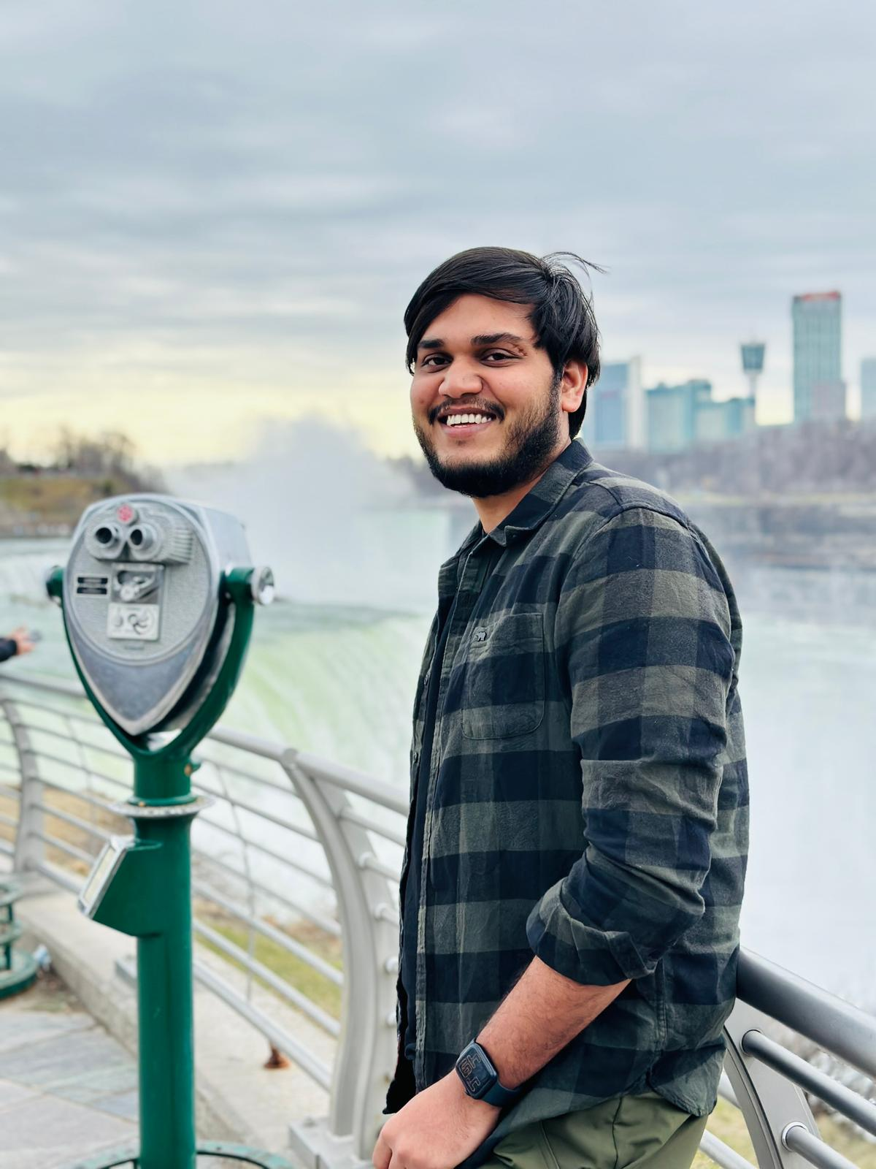
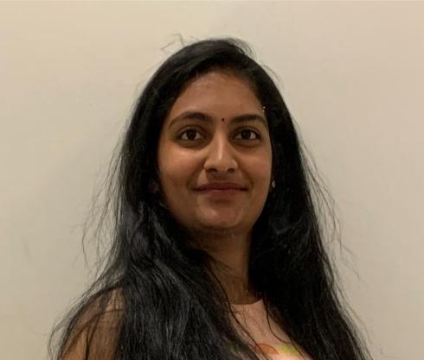
TEAM MEMBERS
Satish kumar reddy indla Developer
Aishwarya Kongari
Developer

Slide 6
Changes based on Professor feedback
More explanation of technologies slides.
Algorithm slide added.
Removal of market analysis

Slide 7
PROBLEM STATEMENT
Many individuals want to maintain a healthy diet but they find it challenging to keep track of their diet and analyse it. The traditional way where keep logging food intake often time and it is prone to inaccuracies, which leads to poor diet choices and even demovitates the individual.
There needs to be a way for a more intuitive and efficient way to understand the nutritional values of fruits and easy to keep track of the intake. Which makes individuals to take healthy diet options.

Slide 8
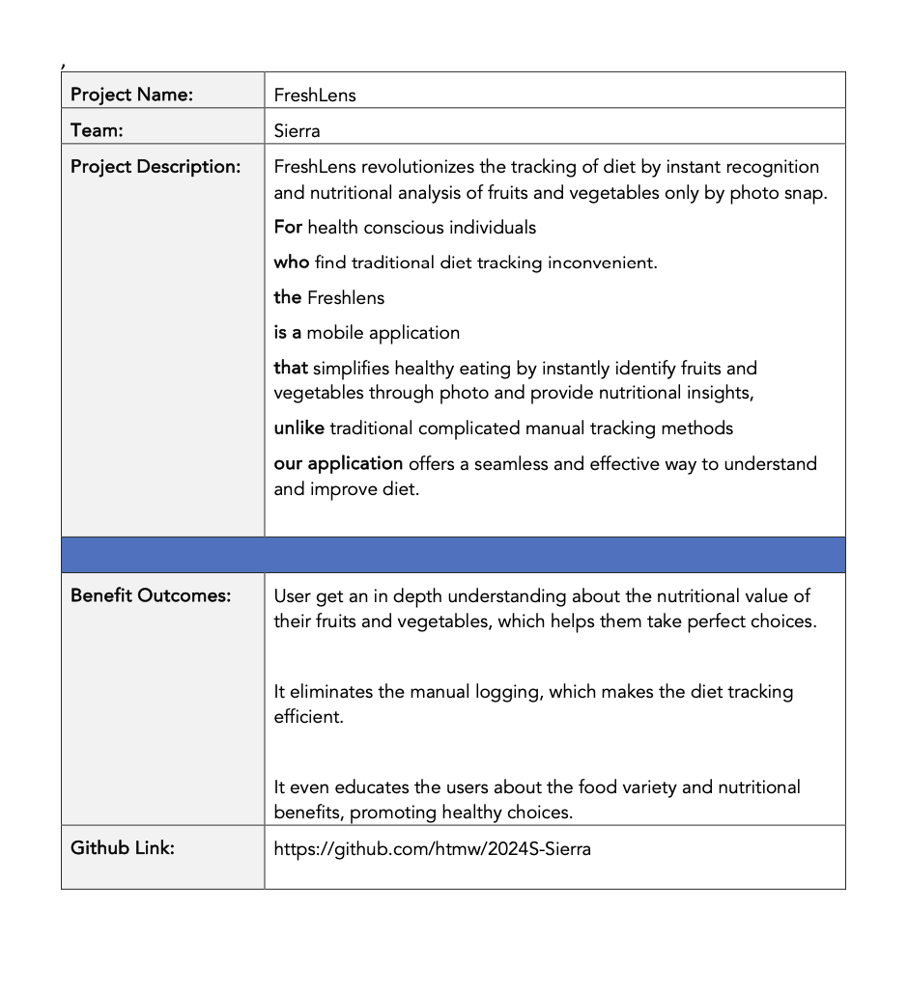
PROJECT DESCRIPTION

Slide 9
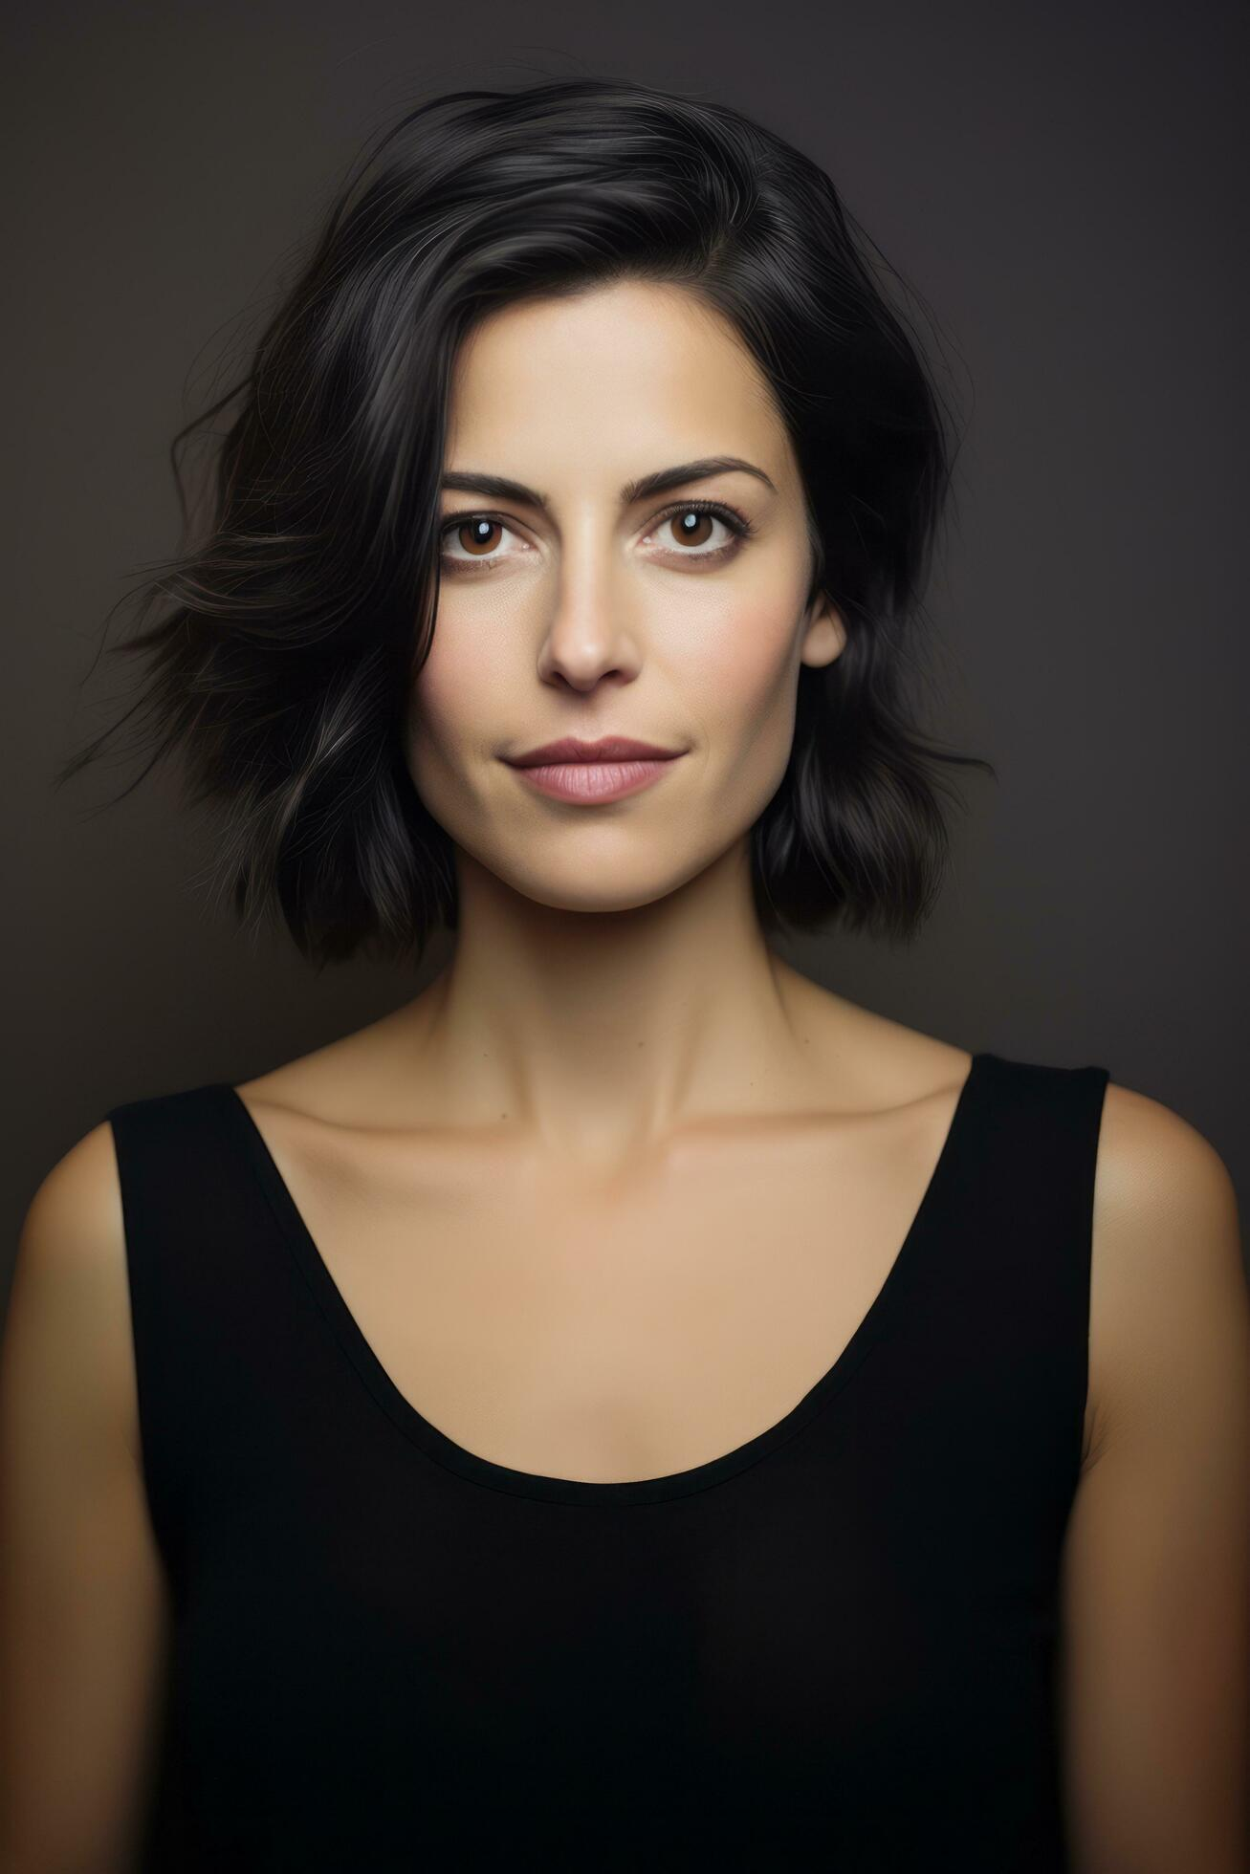
PERSONAS
Name: Emily
Age: 30
Occupation: Marketing Analyst
Interests: Yoga, cooking, and reading health blogs
Goals: Maintain a balanced diet
Challenges: Struggles to find accurate nutritional info for fresh produce
How Your App Helps: FreshLens offers instant nutritional content, supporting her balanced diet and culinary exploration.

Slide 10
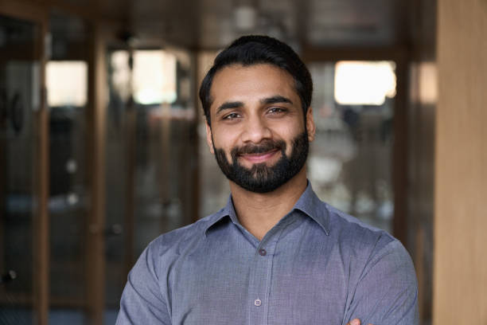
PERSONAS
Name: Alex
Age: 35
Occupation: Software Engineer
Interests: Tech gadgets, hiking, fast cooking
Goals: Eat healthily despite a busy schedule
Challenges: Has limited time for meal prep and nutrition tracking
How Your App Helps: FreshLens easily fits in busy lifestyle, it's designed for healthy eating with quick scan

Slide 11
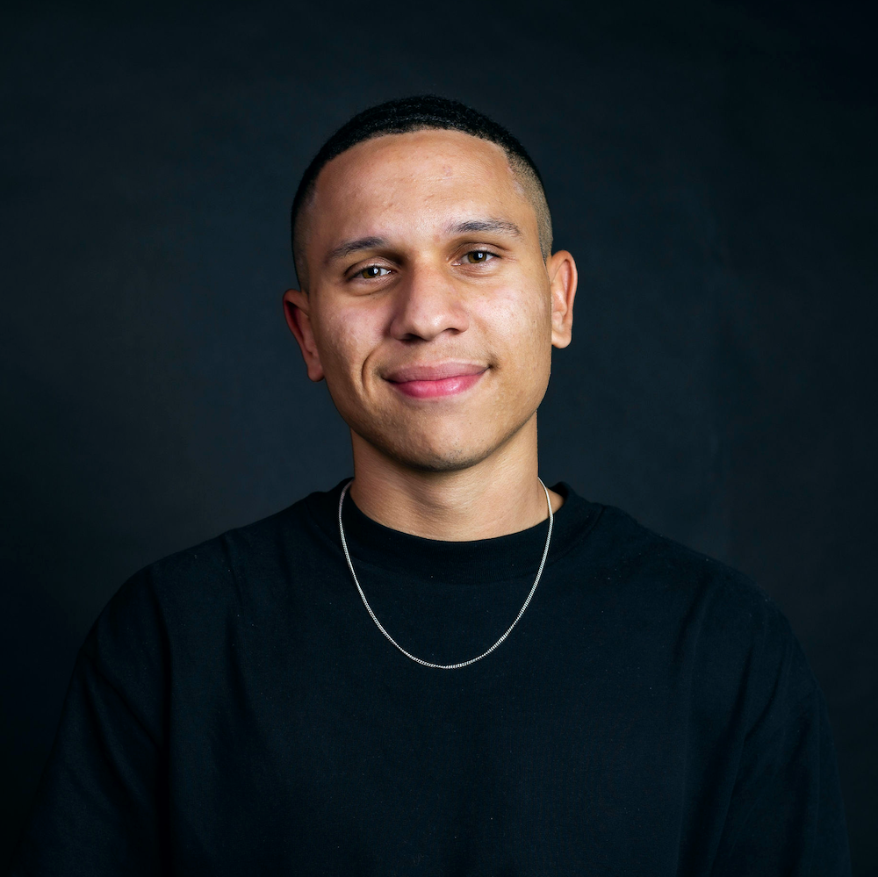
PERSONAS
Name: Jordon
Age: 26
Occupation: Personal Trainer
Interests: Gym workouts, sports nutrition, bodybuilding
Goals: Optimize diet for muscle gain and performance
Challenges: Needs precise macro and micro intake from natural foods
How Your App Helps: FreshLens helps in tracking nutritional values, enhancing his meal planning.

Slide 12
Minimum Viable Product (MVP)
Photo-based food recognition.
User-friendly interface design.
Essential nutritional info display.
User authentication system.
Personal profile customization.
Weekly dietary analysis.

Slide 13


Technologies - Frontend
We will be using React native expo for developing UI for the mobile application and expo is wrapper around react native and it makes prototyping faster.

Slide 14




Technologies - Backend
We will be using node js and fastapi for backend and mongodb as database and its nosql database and even firebase for Authentication and storing images using firebase cloud storage.

Slide 15

Technologies - Machine Learning
We will be using tensorflow to perform machine learning tasking and tensorflow is deep learning framework and it will be used for implementing CNN algorithm.

Slide 16
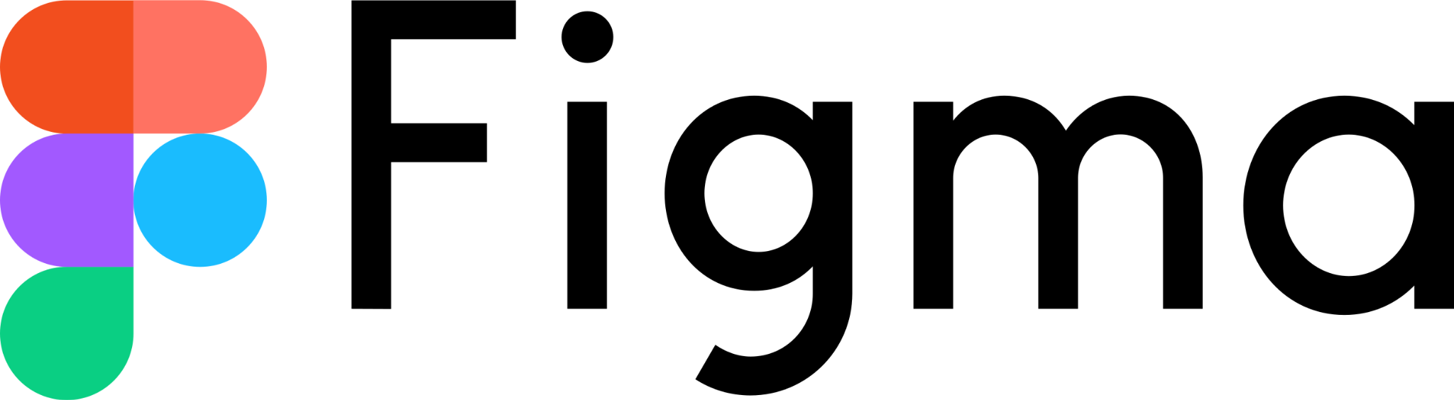
TECH STACK
Figma is used for designing of the application and sharing the application ideas on how it should look like.

Slide 17
Machine Learning Algorithm
CNN Architecture is used.
Inside CNN use of DenseNet121 Algorithm.
The DenseNet model is trained using fruits and vegetables dataset. Due to its efficiency and high accuracy, the DenseNet model effectively learns from the data and accurately identifies objects.

Slide 18
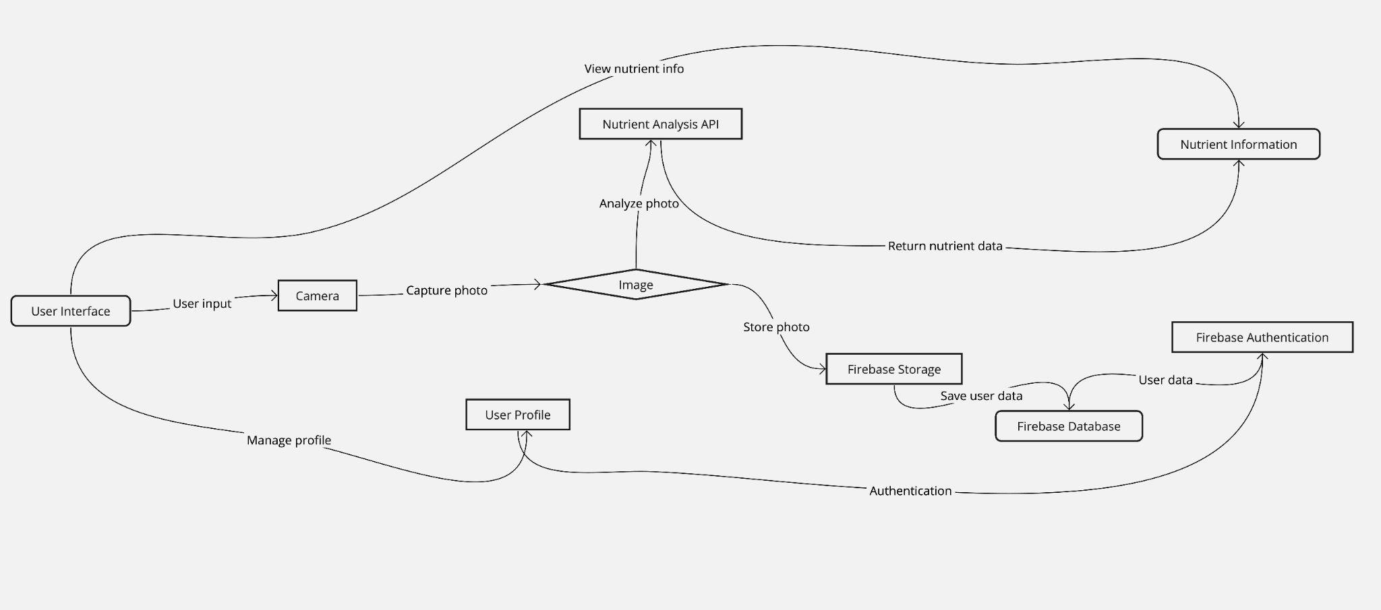
Conceptual Architecture Diagram

Slide 19
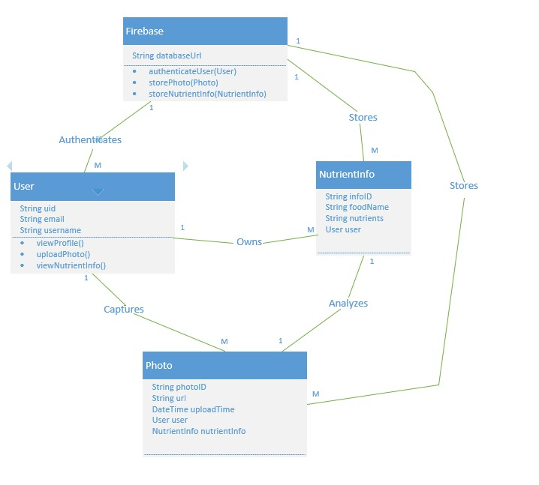
Class Diagram

Slide 20
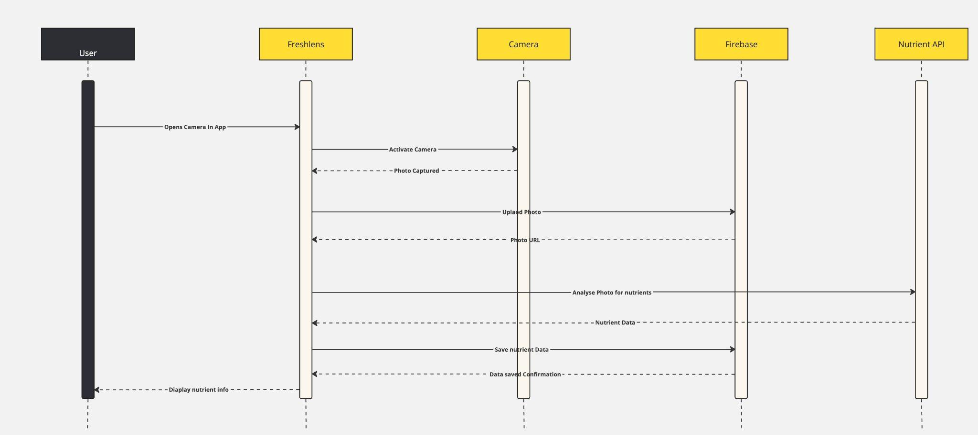
Sequence Diagram

Slide 21
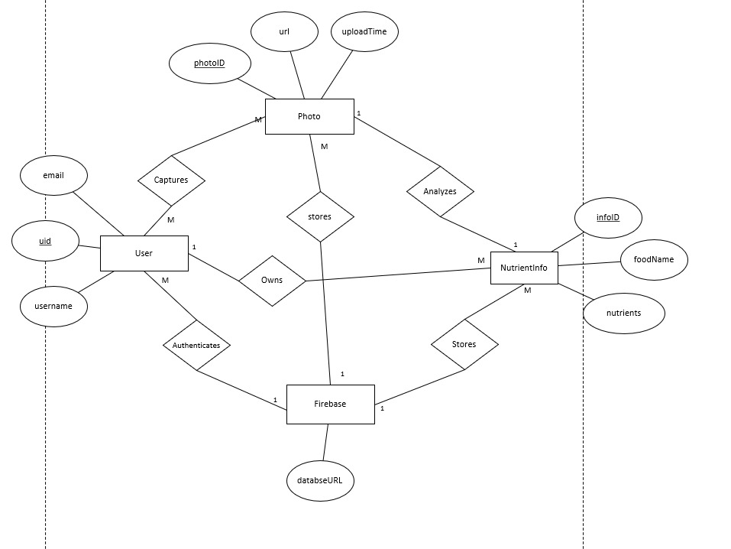
Entity Relationship Diagram

Slide 22
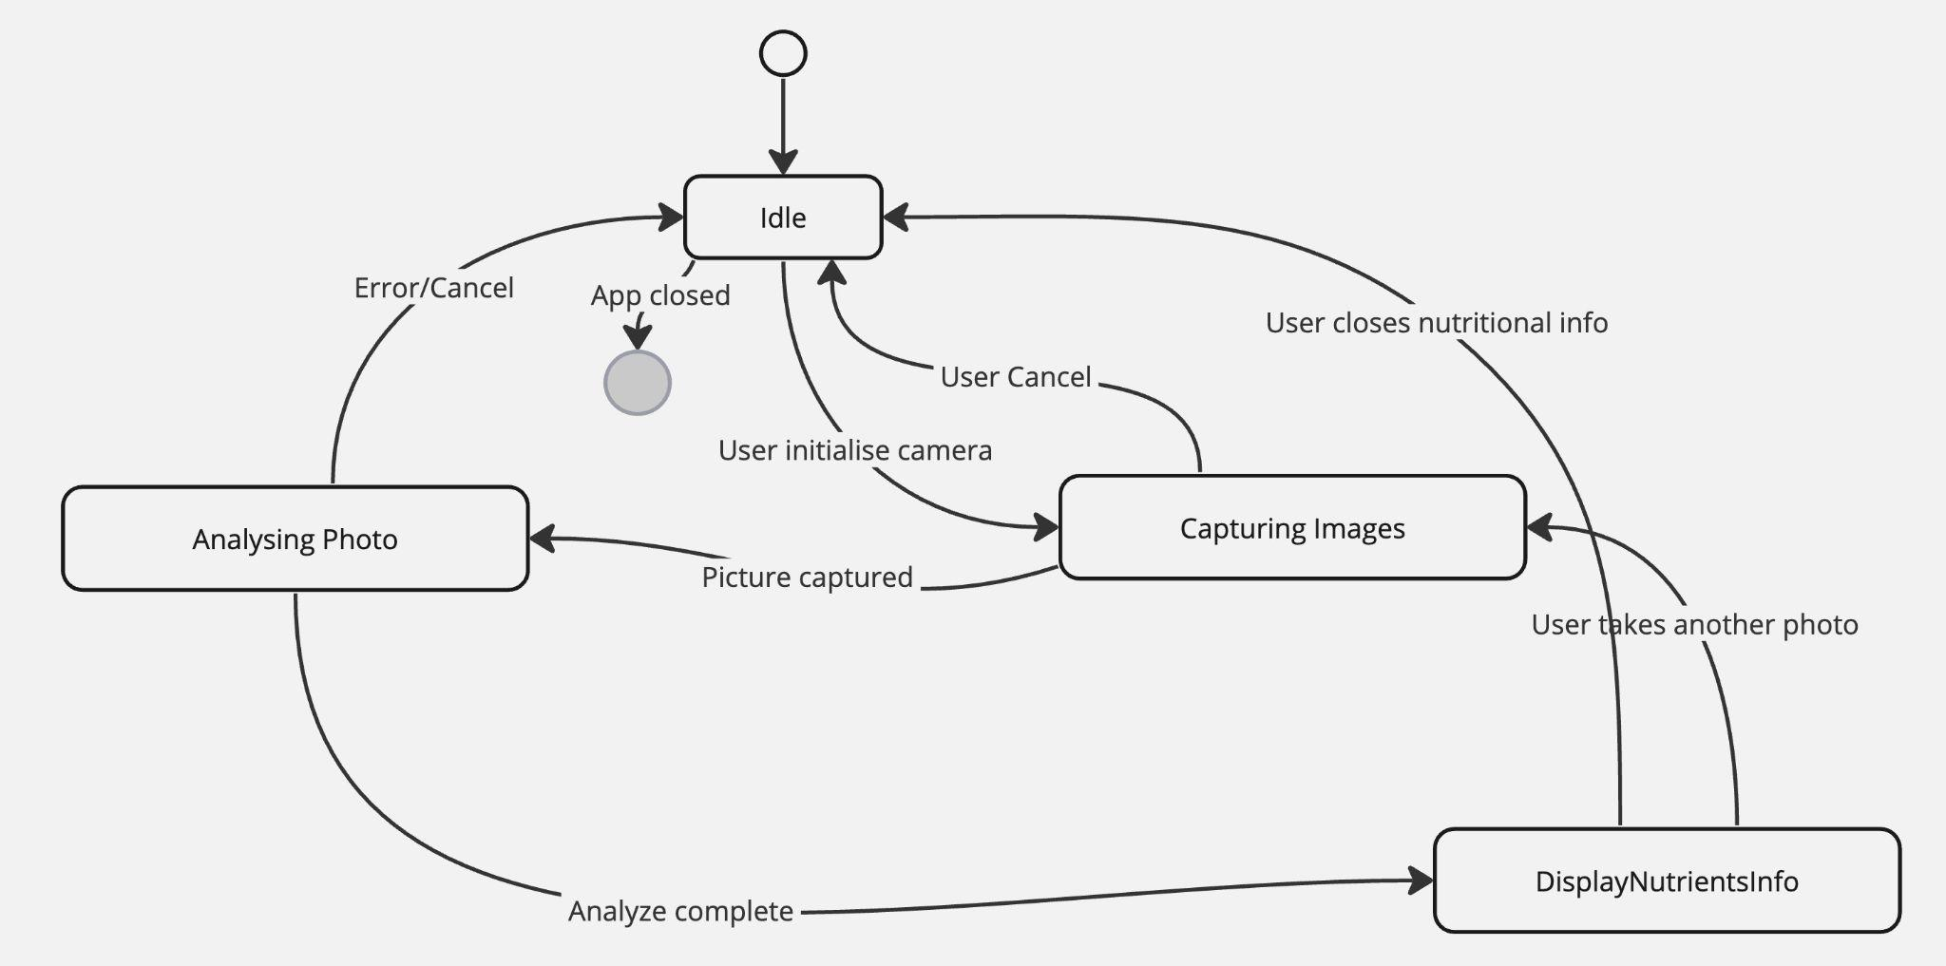
State diagram

Slide 23
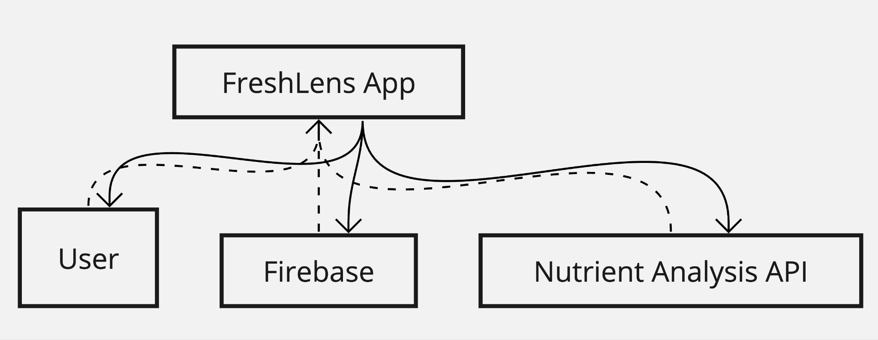
Context Diagram

Slide 24
User Stories In Detail
User Story 1
As a health-conscious individual,
I want to quickly find the nutritional information of various fruits,
So that I can make informed decisions about what to include in my diet.
Acceptance Criteria:
User can search and find fruit nutritional info within seconds.
Display data consists of calories, vitamins, minerals, sugar in clear format.
User Story 2
As a user who is trying trying to maintain a healthy diet,
I want to log my daily fruit intake effortlessly,
So that I can keep track of my consumption and nutritional intake.
Acceptance Criteria:
Fruit logging is via image capturing.
Summary is provided on weekly or monthly based.

Slide 25
User Stories In Detail
User Story 3
As a user who is interested in healthy eating,
I want to receive feedback on my fruit consumption patterns,
So that I can identify areas for improvement and maintain a balanced diet.
Acceptance Criteria:
App gives feedback to user by saying about nutrients.
Get more information about the diet.
User Story 4
As a motivated individual,
I want to set personal goals related to fruit consumption,
So that I can work towards a healthier diet and track my progress.
Acceptance Criteria:
Users can set goals on fruit intake.
Motivational tips are provided to encourage goal achievement.

Slide 26
User Stories In Detail
User Story 5
As a user who is curious about nutrition,
I want to access educational content about the health benefits of various fruits,
So that I can learn more about why certain fruits are beneficial and get motivated to include them in my diet.
Acceptance Criteria:
Blogs about the diet is provided.
Content sharing about importance of healthy food.
User Story 6
As a busy individual,
I want to add fruit consumption into my meal plans,
So that I can ensure that I am consistently incorporating a variety of fruits into my diet.
Acceptance Criteria:
Help in keeping track of their diet.
In hard analysis of their diet.

Slide 27
User Stories In Detail
User Story 7
As a person with specific dietary restrictions or allergies,
I want to filter out fruits that are not suitable for my diet,
So that I can safely adhere to my dietary needs while consuming fruits.
Acceptance Criteria:
Keep in track of user diet restrictions.
Alerts users on any fruit which might cause user an allergy.
User Story 8 :
As a socially motivated individual,
I want to share my fruit consumption goals and achievements with friends,
So that I can enjoy support and friendly competition.
Acceptance Criteria:
Sharing goals is possible.

Slide 28
User Stories In Detail
User Story 9:
As a user interested in local and seasonal fruits,
I want to receive recommendations for fruits based on my location and the season,
So that I can enjoy fresher produce and support local agriculture.
Acceptance Criteria:
Provide benefits about the seasonal fruits.
User Story 10 :
As a user focused on overall health,
I want to track my water intake alongside my fruit consumption,
So that I can ensure I'm staying adequately hydrated.
Acceptance Criteria:
Provides details on which fruit have how much water content.

Slide 29
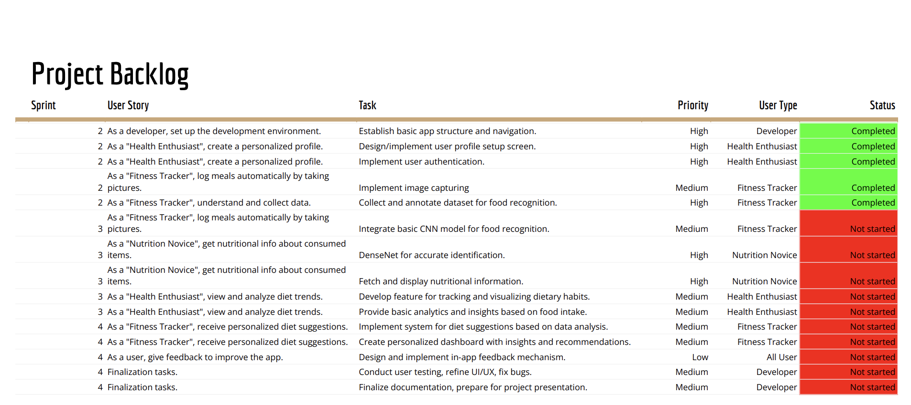
Product Backlog - Overview

Slide 30
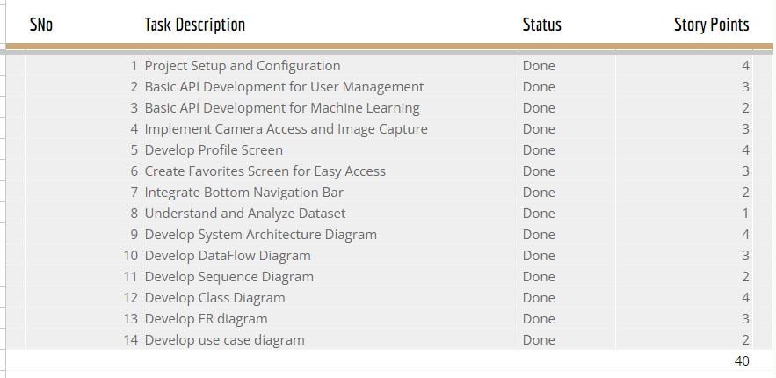
Sprint schedule

Slide 31
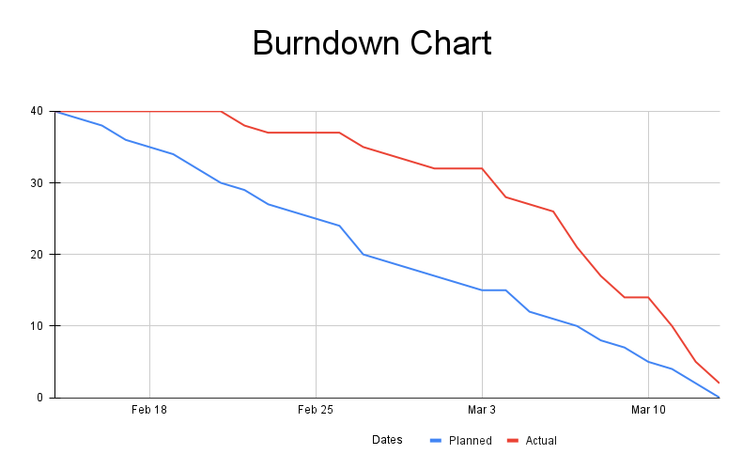
Burndown chart

Slide 32
Testing

Slide 33
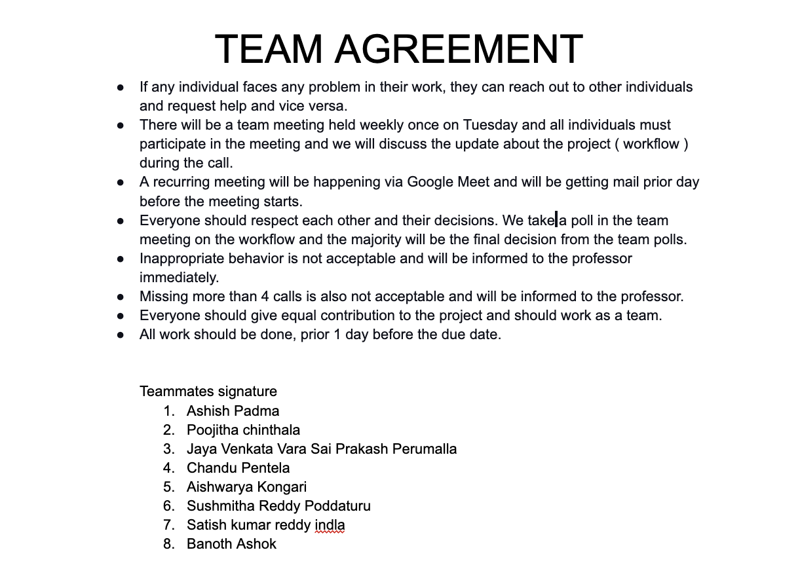
TEAM WORKING AGREEMENT

Slide 34
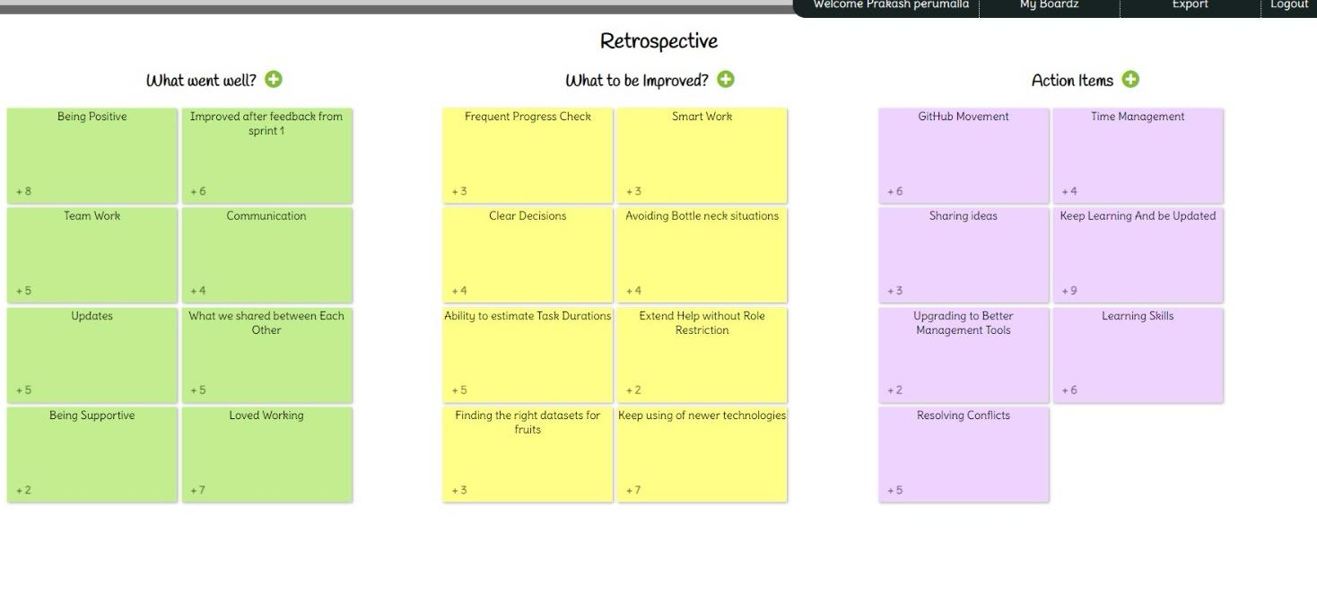
RETROSPECTIVE

Slide 35
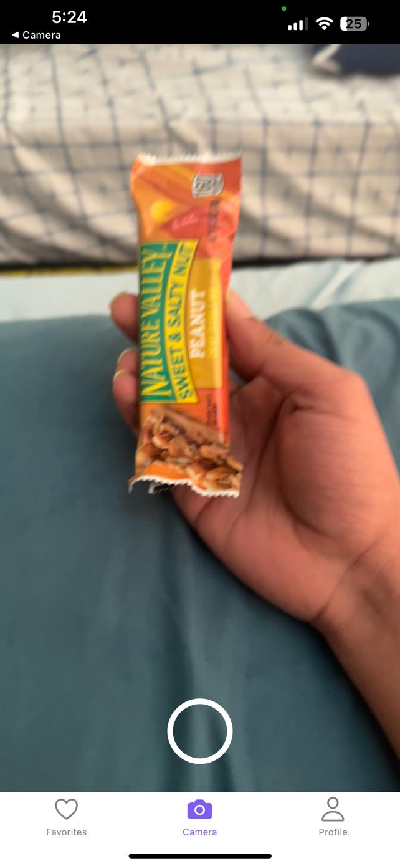
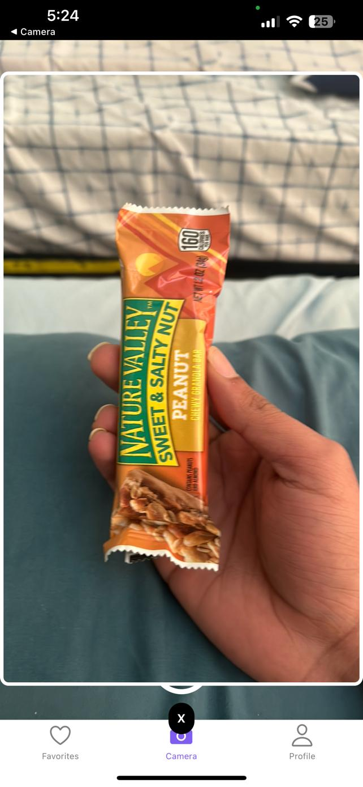
Demo Screenshots
Capture Modal
Favorite
Screen

Slide 36
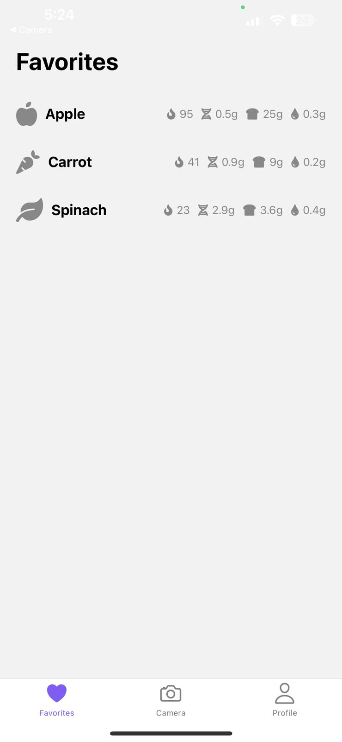
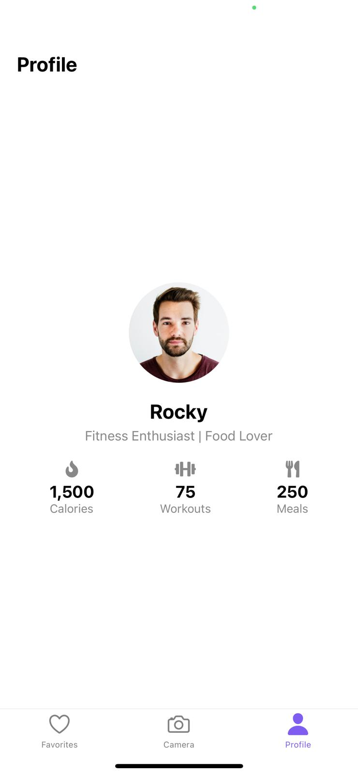
Demo Screenshots
Favorite
Screen
Profile Screen

Slide 37
API / Backend
FastAPI is setup for handling image and even for handling Machine Learning and where as Node js is used for Managing User data and mongodb have nutrients data. Initial REST API is created which have basic end points.

Slide 38
Next Steps
Implement CNN Model
Deploy DenseNet Identification
Design Data API
Visualize Diet Trends
Generate Nutritional Insights

Slide 39
Wikipage link
https://github.com/htmw/2024S-Sierra/wiki

Slide 40
Application Demo

Slide 41
THANK YOU

